Slide 1

TRƯỜNG ĐẠI HỌC BÁCH KHOA HÀ NỘI
VIỆN CÔNG NGHỆ THÔNG TIN VÀ TRUYỀN THÔNG
Bộ môn:Hệ thống thông tin
Đề tài
THIẾT KẾ ỨNG DỤNG NHẬN DIỆN KHUÔN MẶT NGƯỜI VÀ TIẾNG NÓI SỬ DỤNG NGÔN NGỮ PYTHON
GVHD: Thầy Nguyễn Hữu Đức
Sinh viên: Đào Hoài Nam
MSSV: 20173271

Slide 2

Creat train dataset, set label for them & train model
Read all image in forlder dataset
Get the index from name of image, example:
1.1 -> label 1
1.2 -> label 1
2.1 -> label 2
After that, train and save model

Slide 3
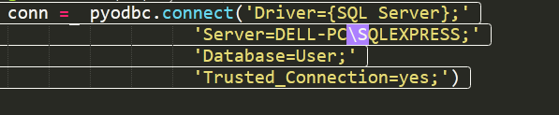
Connect user database
Use library pyodbc to connect database
Get information of user from database

Slide 4
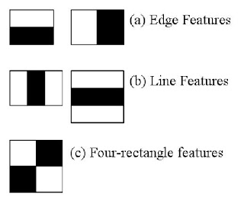
Mô hình xử lí hình ảnh nhận diện khuôn mặt
Using Harr feature – based cascade face classificers
Each feature is a single value obtained by subtracting the sum of pixels under the white rectangle from the sum of pixels under the black rectangle.

Slide 5
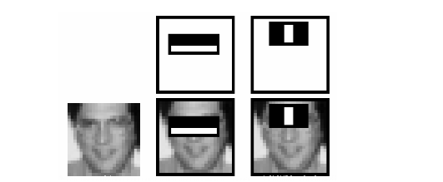
Example about use Harr future to detect face and eyes
The first feature selected seems to focus on the property that the region of the eyes is often darker than the region of the nose and cheeks. The second feature selected relies on the property that the eyes are darker than the bridge of the nose.

Slide 6
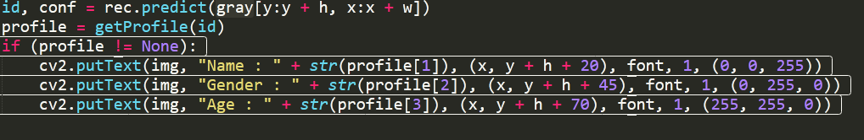
Get ID , search in database & show information
We predict the face base on a region, call ROI. In this case, it is a face
Then, get ID and show the information has the same ID

Slide 7
Listen and recoginize speech
Using speech_recognition libarary in python
And now…
Listen speech and transfer to text
Then, we easily process text!

Slide 8
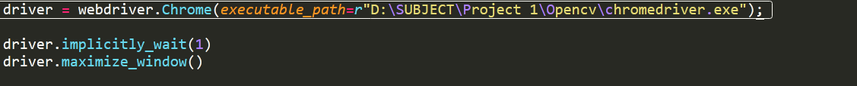
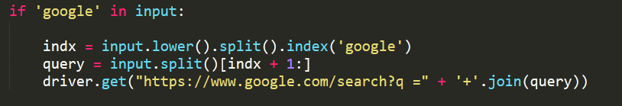
Search web using web driver
We use webdriver from selenium in oerder to do this duty
Then, we can excute some tasks, example:

Slide 9
The end
Thanks for your watching!

Slide 10

